Slide 1

2026-2027
INSTRUCTORS & CONVENORS
Meet our

Slide 2
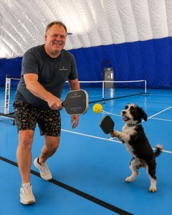
DAVID BUSSIERE
Instructor
Introduction to Pickleball
As one of Canada’s most experienced and certified pickleball instructors, David is passionate about bringing new enthusiasts to the game. He has been involved with this fast-growing sport since 2013, as a player, coach and instructor.

Slide 3
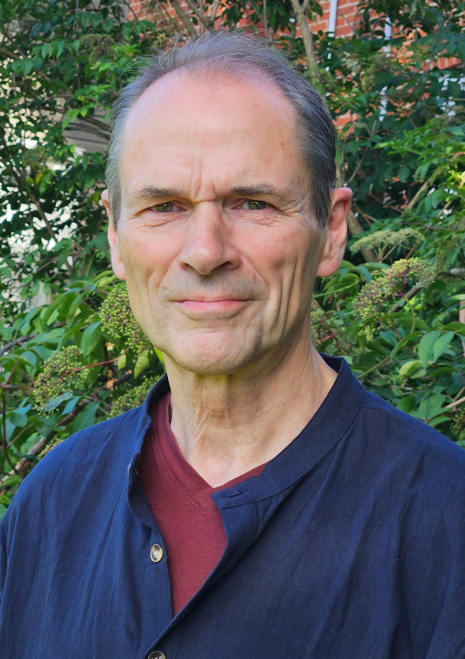
PHIL END
Instructor Qigong
Phil has been practicing Qi Gong and Tai Chi for more than thirty years and is in the process of completing his teacher certification after six years of training. He enjoys giving people practical tools to develop emotional and physical resilience for a long, healthy and active life.

Slide 4
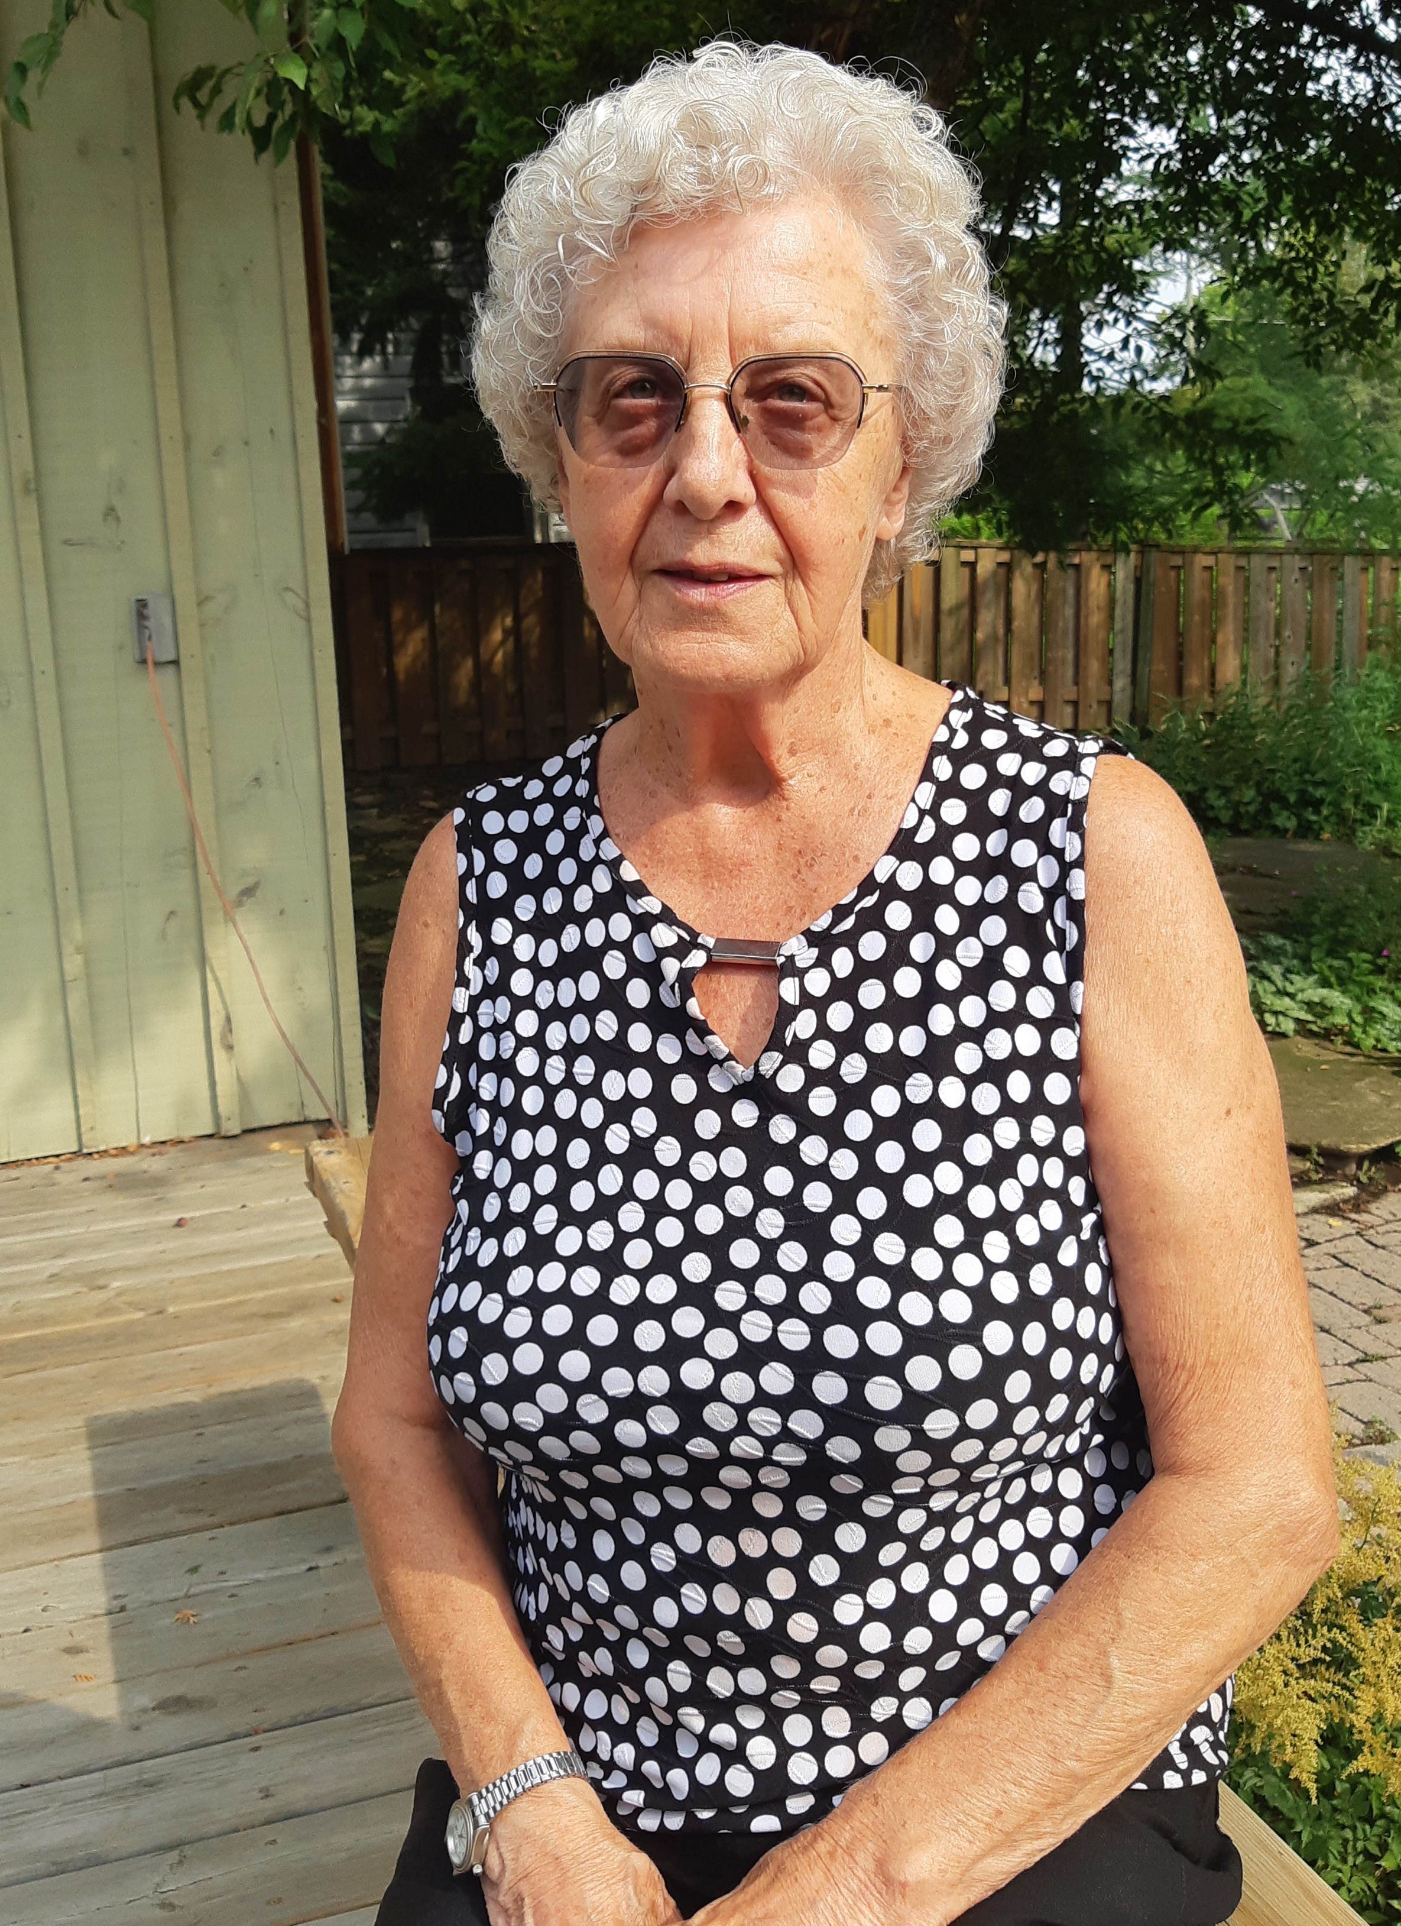
RITA FORTIER
Instructor
Bridge for Beginners
Rita enjoys sharing her love of Bridge, especially with those new to the game. Along with her 50 years of experience playing Bridge, she is also a qualified teacher having taught elementary and secondary in Ontario for many years (in both English and French!).

Slide 5
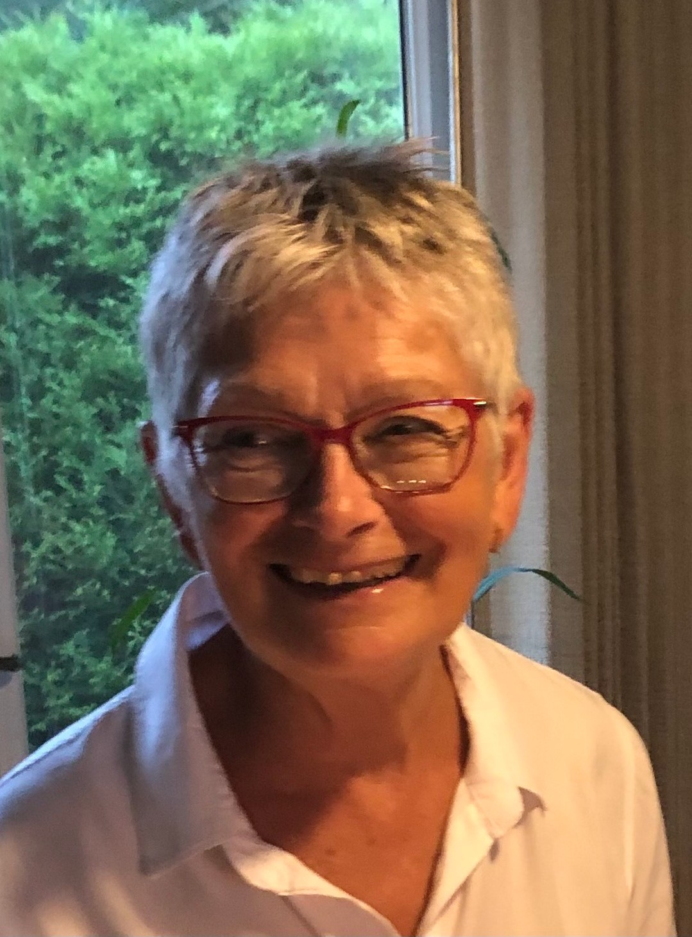
GISELE GILFILLAN
Instructor
Experience Meditation
Gisele has been meditating for past 25 years having first learned the practice on retreats with a Buddhist teacher while in the Ministry of the United Church.
Gisele has worked with seniors since 1999 and takes pleasure in sharing meditation methods with the community in Seeley’s Bay and Gananoque.

Slide 6
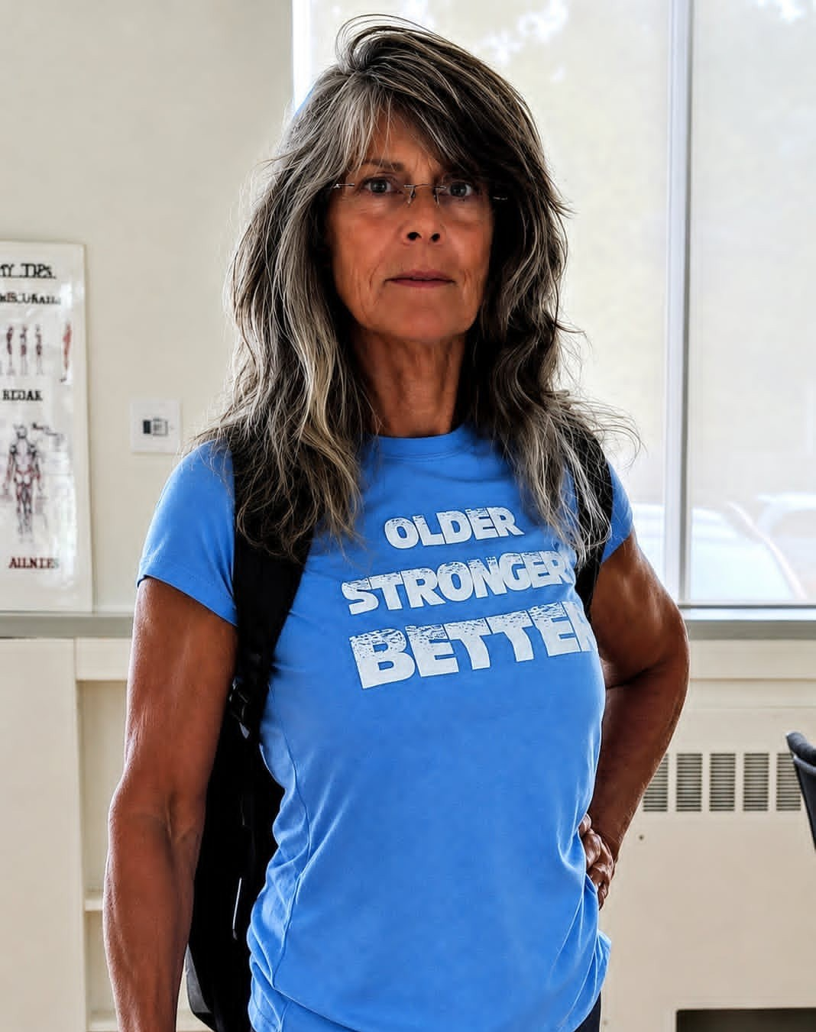
SUE GOFF
Instructor Better Balance Better Core
Sue is a certified Seniors Fitness Course Instructor through CCAA Canadian Centre of Activity & Aging, a division of Western University. She finds it
rewarding to support and encourage seniors to stay active, and enjoys promoting healthy living through her with the GSA, VON and CPHC.

Slide 7
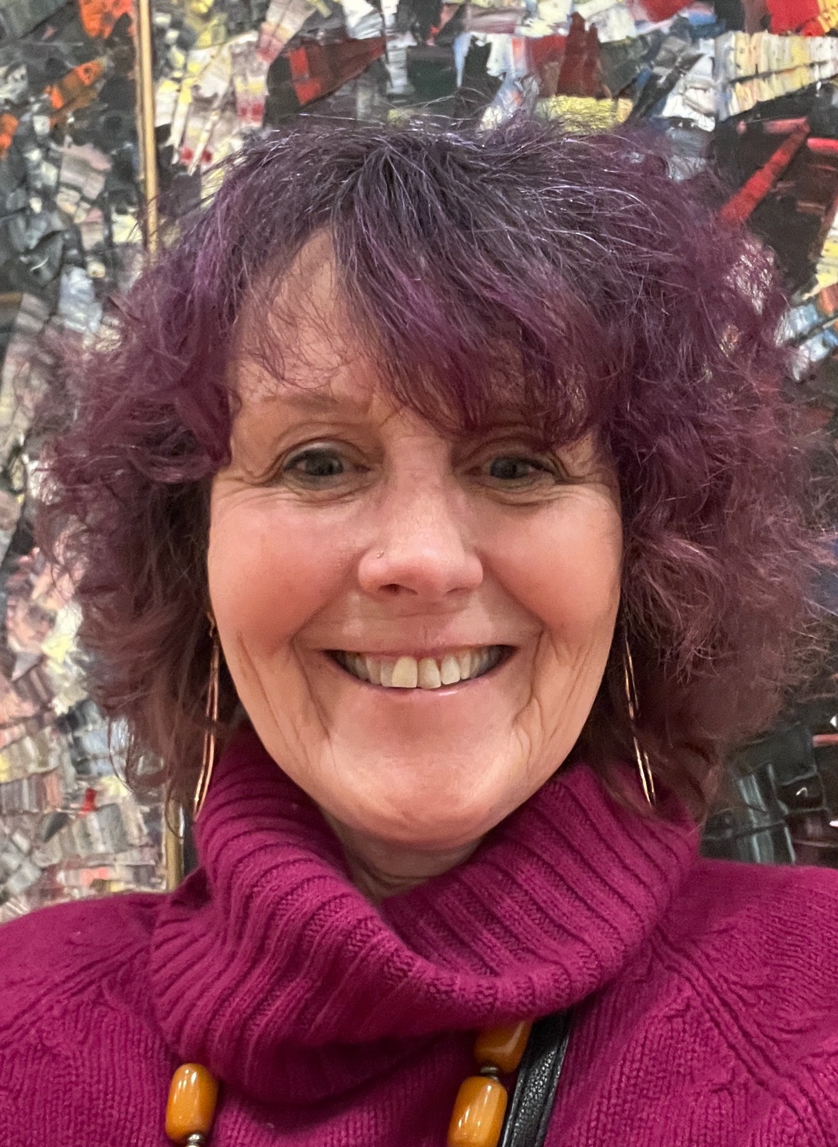
SU HALLE
Instructor
Chair Fitness Fusion Chair Yoga
Sit and Get Fit
Su has 30+ years of experience as a fitness and yoga instructor with certifications from Can Fit Pro including Personal Trainer, Group Fitness, Mind Body Fitness, Older Adults Fitness and Certified Wellness Coach (ICF accredited program) and YMCA instructor certification in Strength Training and Group Fitness. She also holds certifications in yoga with 1000+ hours of training. As one of the GSA's original instructors, Su has always had a love for movement, wellness and community building and brings a light-hearted approach to growing older.

Slide 8
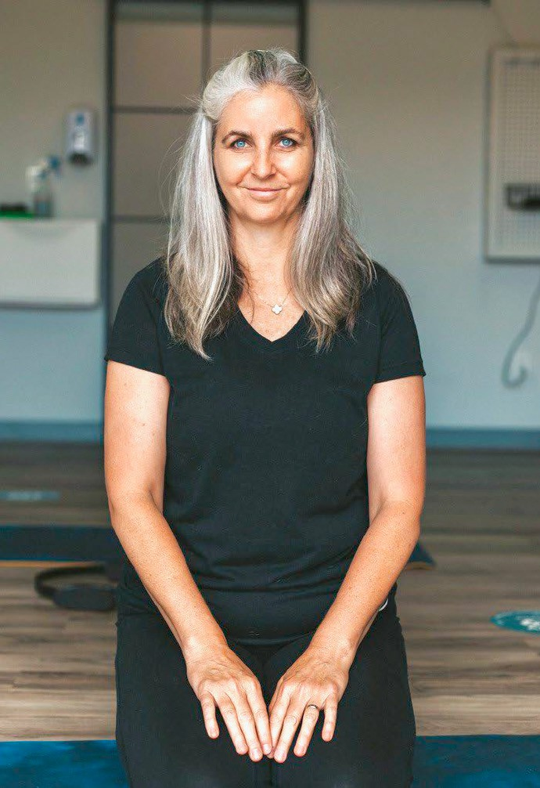
GLORIA LAUX
Instructor Essentrics MELT Method Pilates
Gloria enjoyed dance and movement her entire life (since three years of age) eventually becoming an instructor 30 years ago. Her instructor training and accreditation continues to evolve as she discovers new passions, but certifications specifically include Pilates, MELT and Eccentrics.

Slide 9
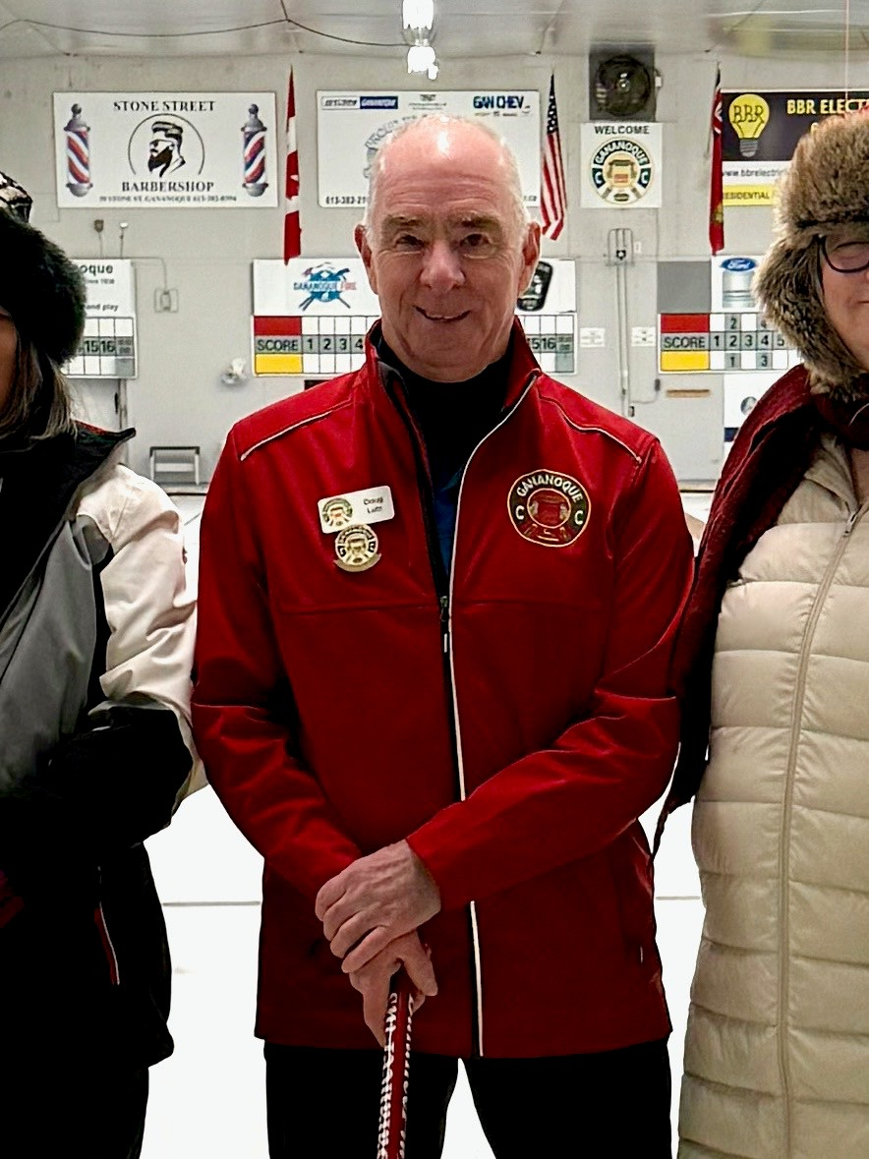
DOUG LUTZ
Instructor Learn to Curl
Doug has been curling for over 30 years and has been teaching Adult Learn to Curl courses at Garrison Curling Club and Gananoque Curling Club for nearly a decade. He enjoys introducing this social sport to interested seniors and has instructor certifications from the Ontario Curling Association (Level 1 Coaching) as well as Ontario Curling Council (Adult Learn to Curl).

Slide 10
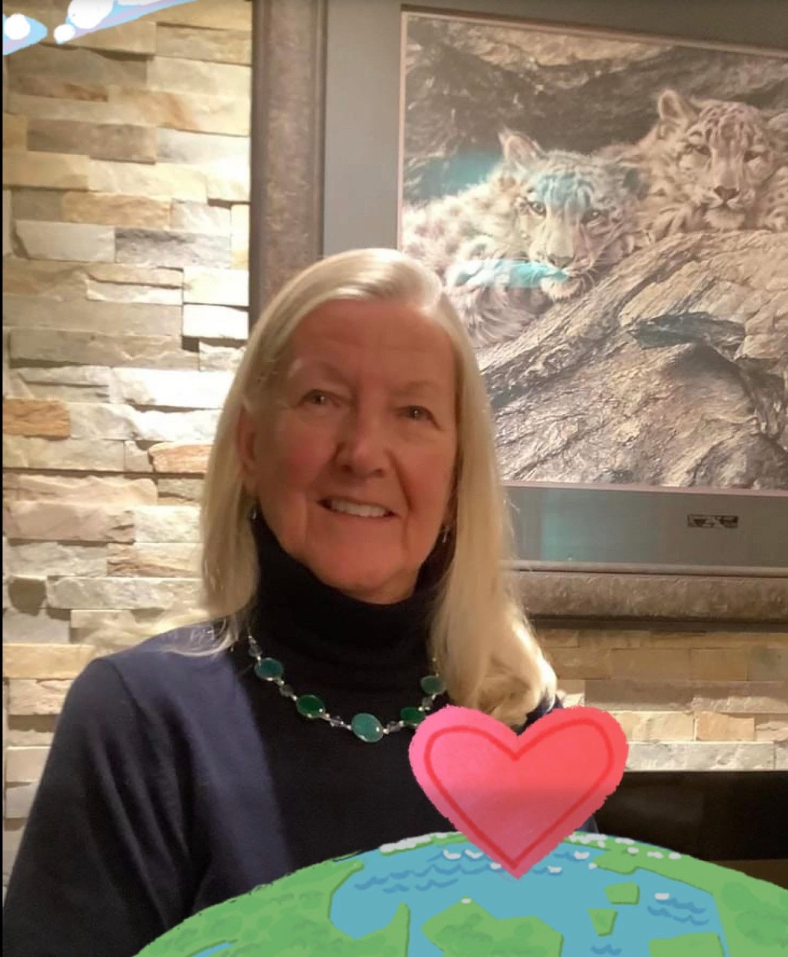
BARBARA PENKMAN
Convenor
The Travel Exchange
Barbara knows world travel from working for a large hotel company. In addition to corporate roles, she has leadership experience with community service groups and post-secondary education. Barbara continues to appreciate travel experiences in her personal life and looks forward to facilitating the exchange of travel stories and photos among our Gan Seniors.

Slide 11
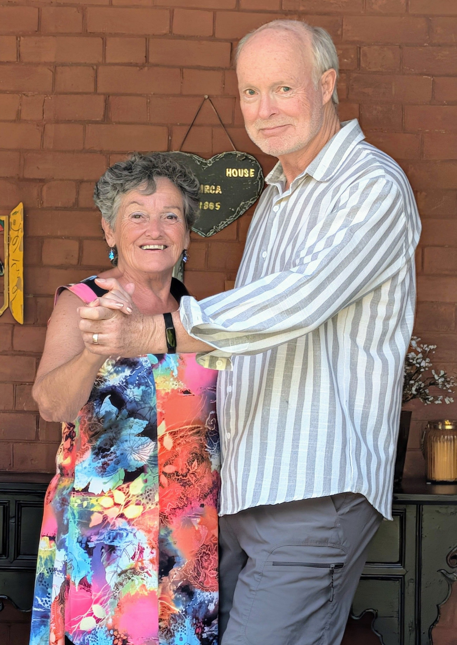
KEVIN QUINN
Instructor Step by Step
Kevin has been teaching social dancing (with Suzanne) for the past three years. He enjoys working with seniors in a fun environment and has the perfect qualifications having studied adult education at the doctoral level at OISE/UT and and Instructor Training for one year at Joy of Dance Teacher Academy.

Slide 12
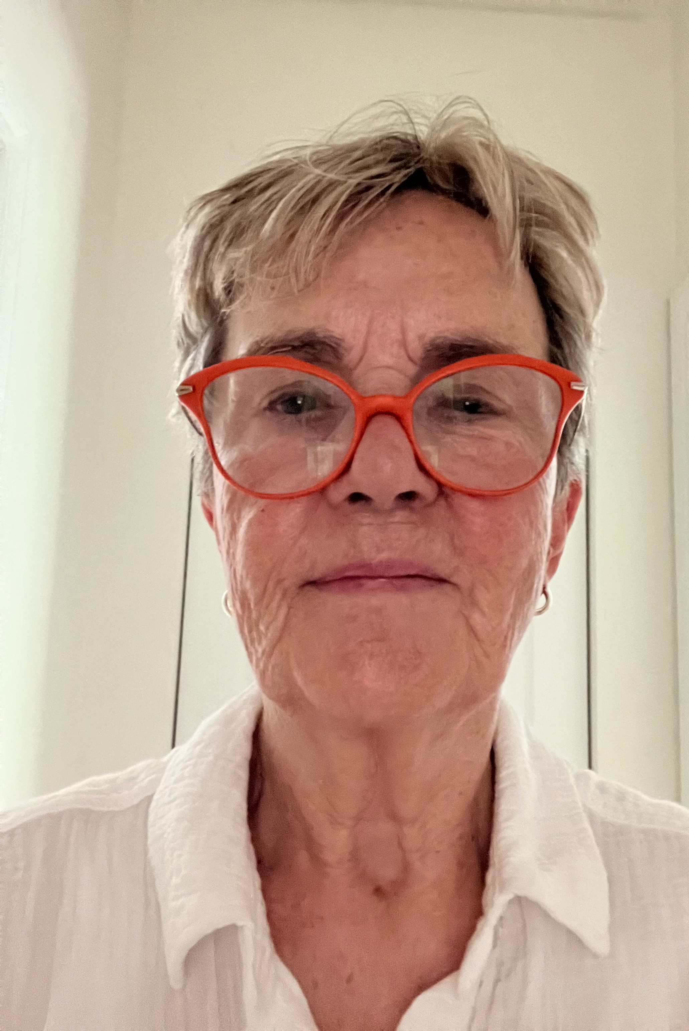
BEV SADLER
Instructor Yoga Asanas
Bev is an avid yogi, practicing hatha yoga asanas, pranayama and meditation, for two to three hours a day. She has completed extensive training on these disciplines at the Isha Institute (at their ashram in Tennessee and the main ashram in Coimbatore, Tamil Nadu, India) and looks forward to continuing to share her passion for yoga (and its many benefits) with Gan seniors.

Slide 13
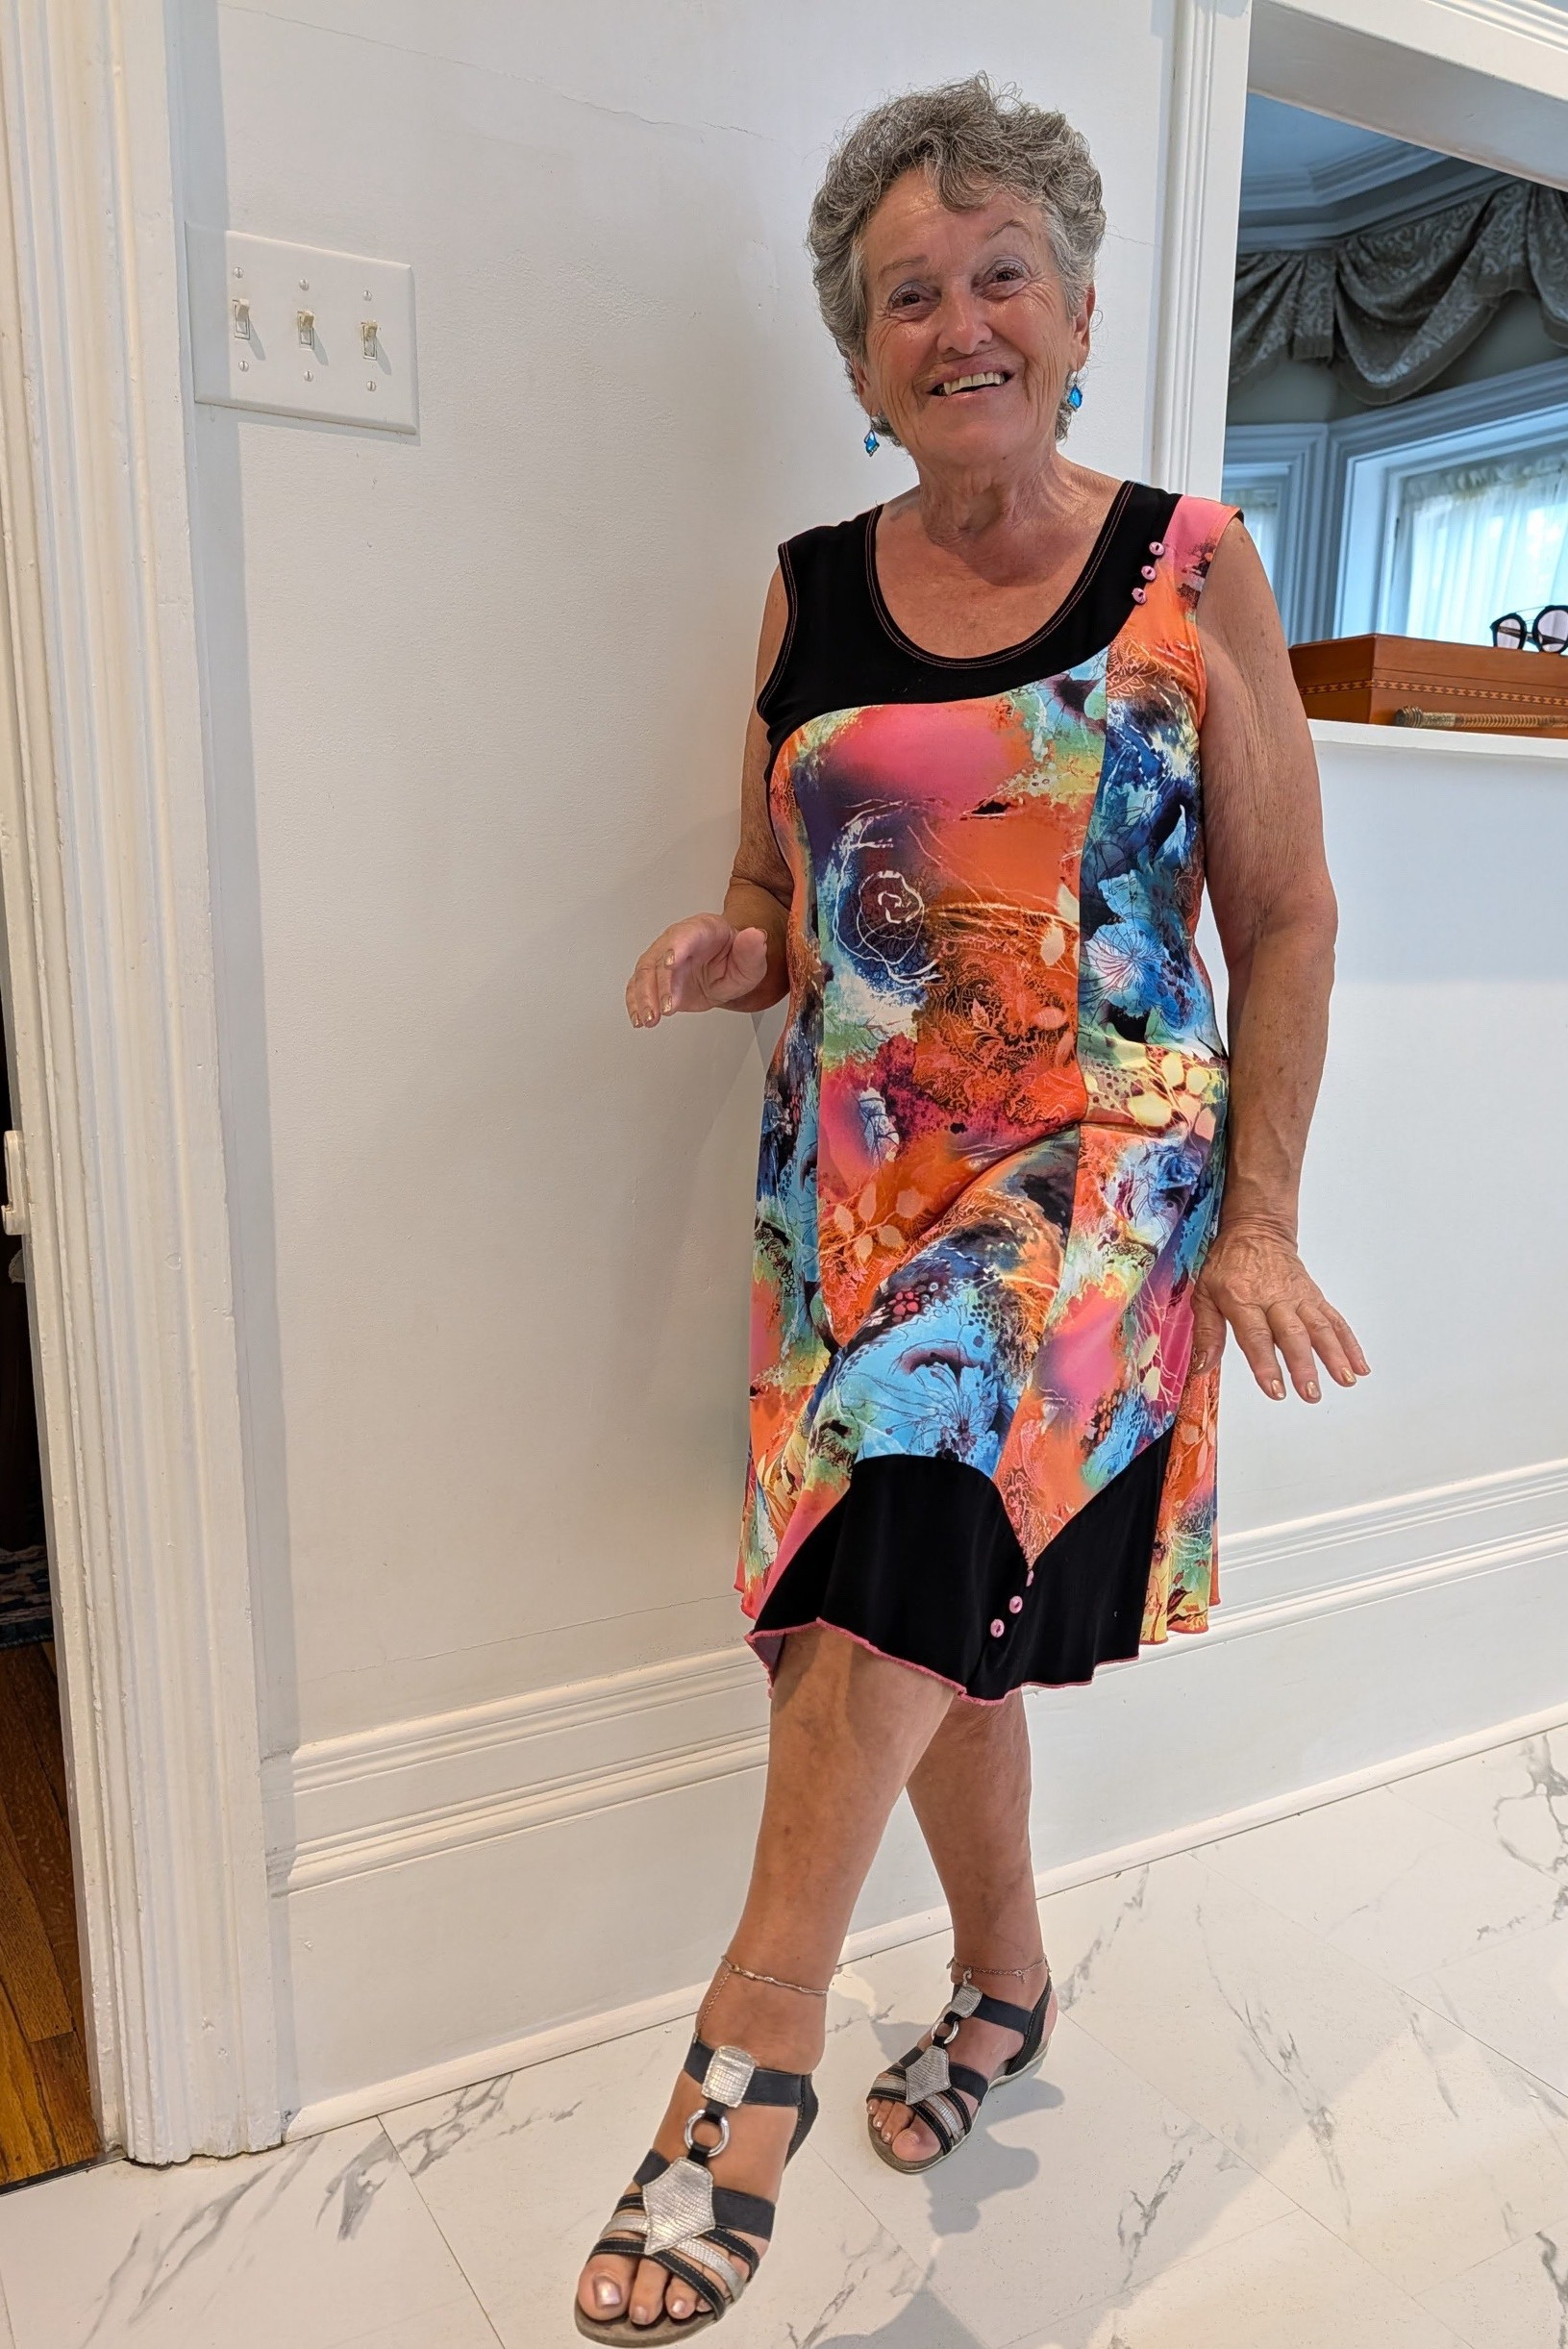
SUZANNE ST. PIERRE
Instructor Step by Step Line Dancing
Suzanne has been dancing for 35+ years and well appreciates the fun social benefits as well as the physical and brain gains. She has spent the last six years sharing her love of dance by teaching Line Dancing and Social Dancing (Step by Step with Kevin) to seniors through the GSA and community groups.

Slide 14
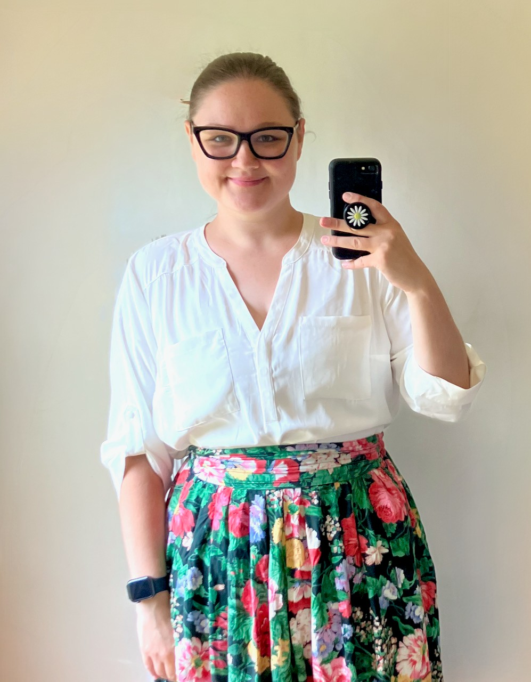
EMMA TIMUSK
Instructor
Cell Phone 101
Gan Seniors Walking Group
Emma one of those tech-savvy millennials who was raised with technology but was surrounded by older folks who always needed explanations and help.
She supported students as a studio supervisor at Centennial College (where she earned a diploma in Fine Art) and now works as the Administrator of the
Gananoque Seniors Association.

Slide 15


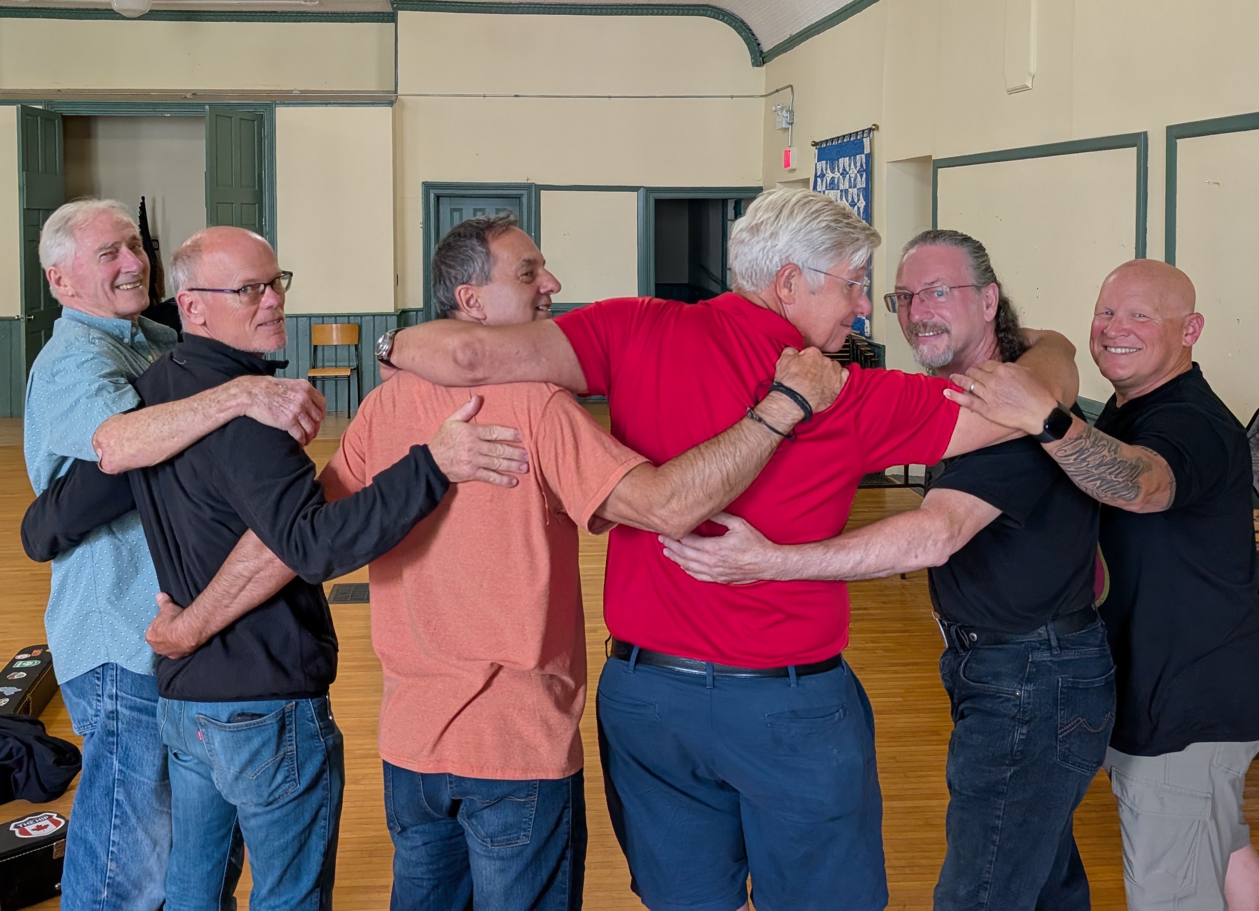

KEN WILSON, STEPHEN BEARDWOOD et al
Convenors Guitar Choir
The Guitar Choir is a group of musicians (of intermediate to advanced ability) who share their knowledge with each other at a weekly get-together, often tackling a song or two at each meeting. There is no official instruction, just the shared love of learning and playing new music together.

